Slide 1

LISSA- Live Interactive Social Skill Assistance
Mohammad Rafayet Ali, Dev Crasta, Li Jin, Agustin Baretto, Joshua Pachter, Ronald D. Rogge, Mohammed Ehsan Hoque
Notes:
Hi, I am Mohammad Rafayet Ali. Today I am going to present a new tool “LISSA”.

Slide 2

Motivation & Background
People often desire help improving their social skills
Lack of resources and availability
Social Stigma
Expensive
Notes:
Having a good conversational skill is very important now a days and people want to improve their social skills. The best way an individual can get help is by having a training session with real human beings. However, people often don’t know where to get a social skills training. There are a lot of training centers and workshops out there but choosing the right one is really confusing. Some of these social skills training are expensive too.

Slide 3
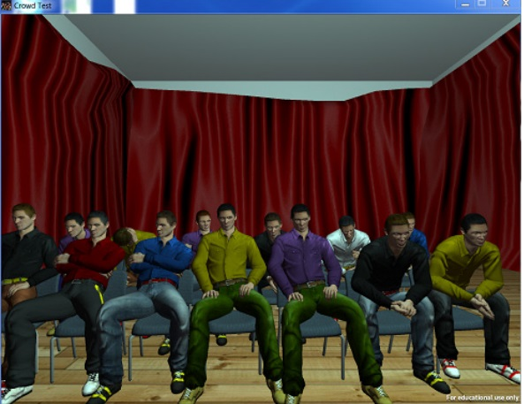
Cicero
L. Batrinca, G. Stratou, A. Shapiro, L. P. Morency, and S. Scherer, “Cicero - Towards a multimodal virtual audience platform for public speaking training,” Lect. Notes Comput. Sci. (including Subser. Lect. Notes Artif. Intell. Lect. Notes Bioinformatics), vol. 8108 LNAI, pp. 116–128, 2013.
Notes:
There has been a lot of work done in this area. In particular – Cicero which was published in 2013 used multimodal virtual audience platform to train public speaking. These virtual audiences can give real-time feedback in subtle way by showing certain behaviors. However, finding the most effective way of giving real-time feedback without making the users distracted is still a research challenge.

Slide 4
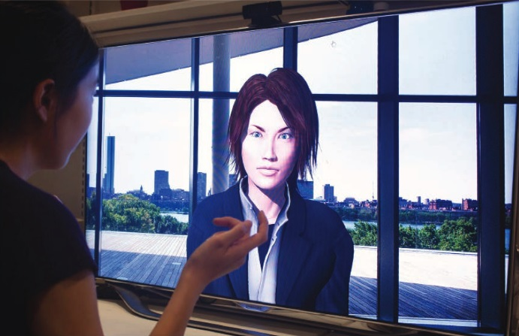
MACH
M. E. Hoque, M. Courgeon, B. Mutlu, J-C. Martin, R. W. Picard, MACH: My Automated Conversation coach, Proceedings of 15th International Conference on Ubiquitous Computing (Ubicomp), September 2013.
Notes:
Another work called “My Automated Conversation coacH” used virtual agent to give focused summary feedback to train individuals in the context of job interview. It also gave a subtle real-time feedback by mirroring smile.

Slide 5
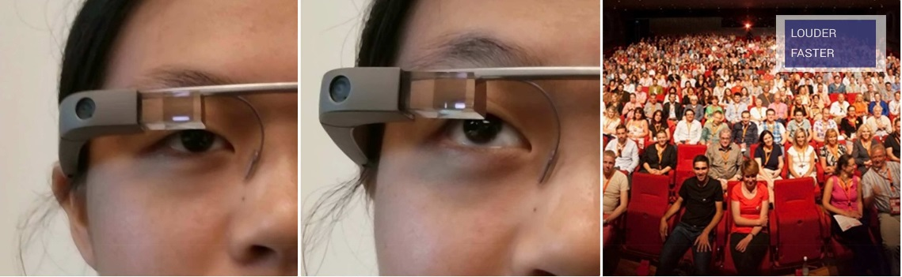
Rhema
M. Tanveer, E. Lin, M. E. Hoque, Rhema: A Real-Time In-Situ Intelligent Interface to Help People with Public Speaking, Intelligent User Interfaces (IUI), April, 2015.
Notes:
Recently from our Rochester HCI lab a work has been published called “Rhema” which uses wearable technology to give real-time feedback during a public speech. Designing the feedback they found that if we put too much information then it puts a lot of cognitive load on user. That’s why they chose to give the feedbacks by showing some text when it is necessary as oppose to show some graphs and lines continuously.

Slide 6
LISSA
Get real-time feedback in a non-distracting way.
Have a conversation with virtual agent
Improve conversational skills and compare between sessions.
Notes:
From these we came up with an idea where individuals seeking for social skills training can have a conversation with a human like virtual agent and get real time and summary feedback. Our system allows individual to compare themselves between their training sessions.

Slide 7
Technical challenges
How do we design real-time feedback?
What behaviors we can target?
Can the user reflect on these feedback in real world?
Notes:
There are some fundamental challenges in designing such kind of system. How do we design real-time feedback such that it is non-distracting, easy to process and effective in the real world.
What behaviors we should target? There are a lot of verbal and non-verbal behaviors on which users may want to improve. The next challenge is even if we give them the real-time feedback can they reflect on these in the real world?

Slide 8
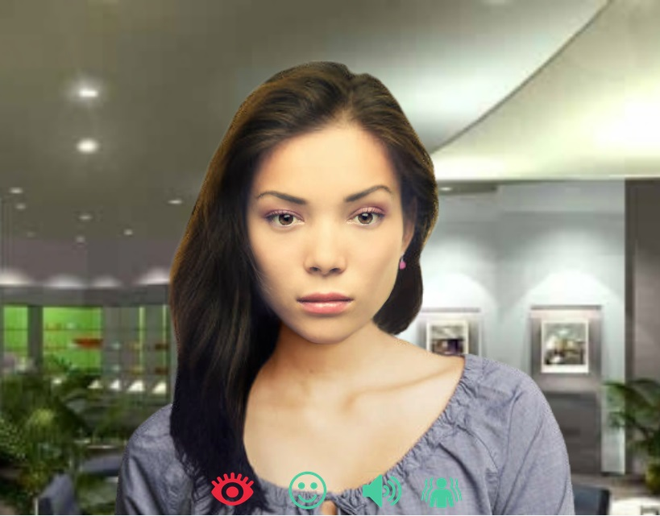
Real-time Feedback
Notes:
Now lets talk about our system. This is our user interface. There is our virtual agent. People can have a conversation with this virtual agent. At the bottom of this interface you can see four icons which represents four non-verbal behaviors, eye-contact, smile, volume, and body language. The icons are green by default. During the conversation can go red prompting the user to adjust corresponding behavior. For example if the eye-contact icon turns red it means the user is not making enough eye contact.

Slide 9
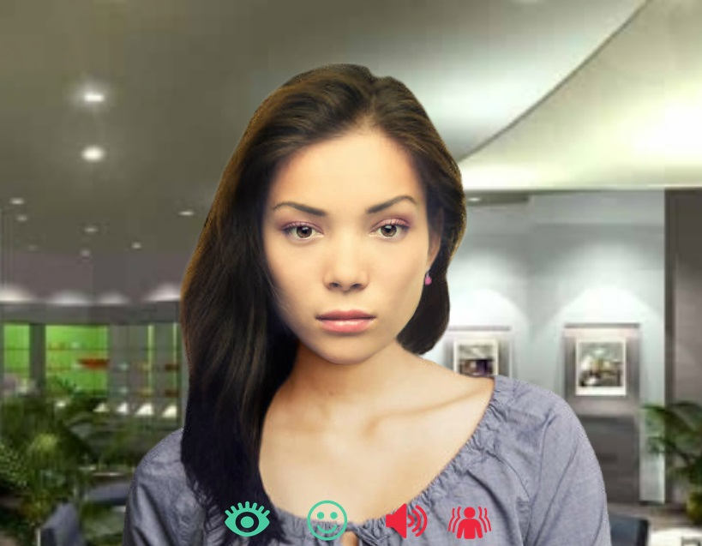
Real-time Feedback
Notes:
We only considered four non-verbal behavior because too many icons may put heavy cognitive loads on users and these behaviors are easy to identify. In future we’ll experiment with other non-verbal behaviors too.

Slide 10
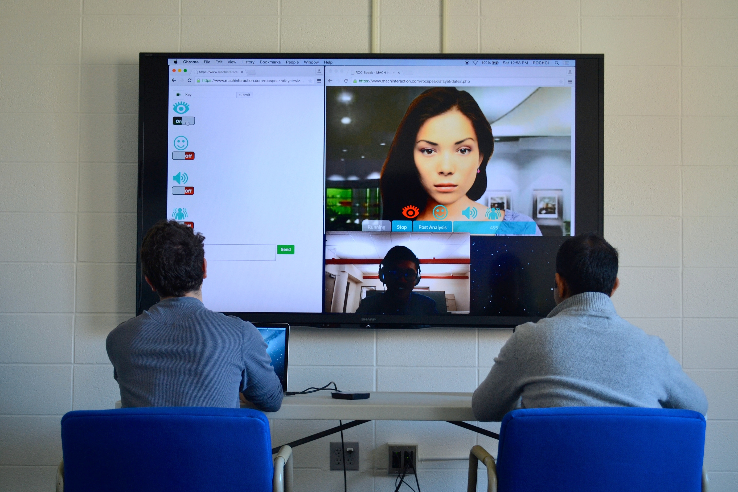
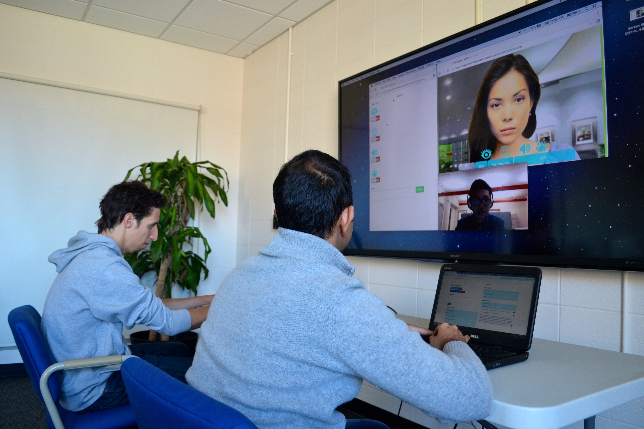
Wizard of Oz
Notes:
How did we managed to give the real-time feedback and conducting a conversation? As we don’t have any training data we used a wizard of oz technique to conduct our study. There were two persons behind the scene. One was the coach, who was responsible for giving the real-time feedback and the other wizard was the operator who was responsible for conducting the conversation.

Slide 11
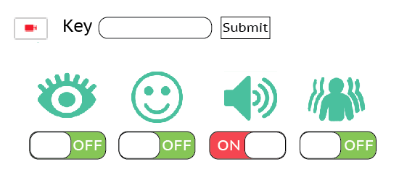
Real-time Feedback
Notes:
This is the interface of the coach. By turning on and off these buttons, coach can control the icon flashing on user’s interface.

Slide 12
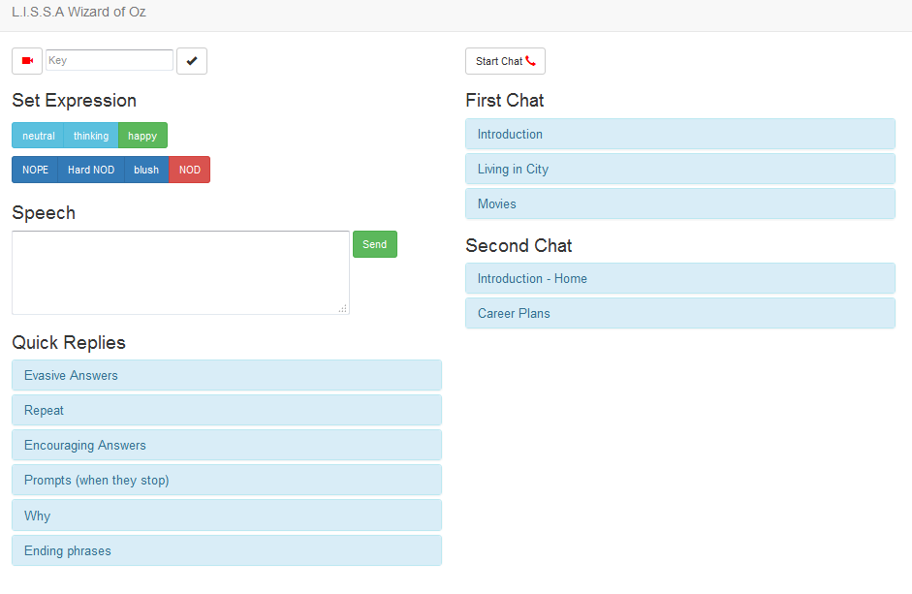
Running Conversation
Notes:
This is the interface of the operator who controls the avatar. In the right side you can see there are some pre-scripted dialogues. By clicking on them the operator can make the avatar say that particular text.

Slide 13
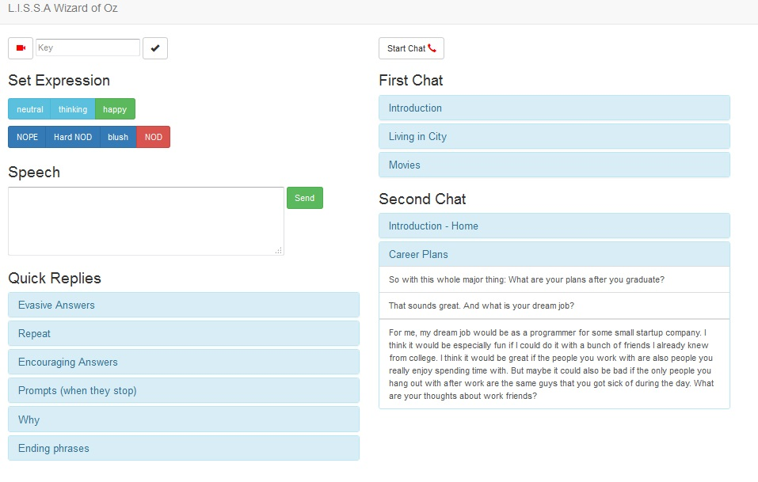
Running Conversation
Notes:
On the left side you can see there are some buttons which were used to control the avatar’s expression and there are some quick replies buttons too.

Slide 14
Running Conversation
Have you seen the movie “Guardian of the Galaxy?”
Are you into superhero?
Yes
I like books
No
I’d rather not talk about myself
I’d like to hear more about you?
I like books too,
but I prefer movie
Then, what is your
favorite move?
Who is your
favorite character?
Notes:
We always tried keep our conversation on our predefined topics. In our study, whenever a participant tried to talk about something other than our predefined topics we used our quick replies to keep the conversation on our topics. For example, when the avatar says “Have you seen the movie GoG?” the user can respond by saying “Are you into superhero?” The avatar would then say “I’d rather not talk about myself, I’d like to hear more about you”. If the user can say “I like books”. The avatar would then say “I like books too, but I prefer movies”.

Slide 15
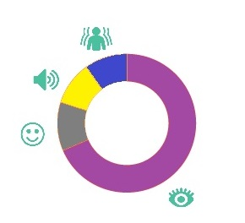
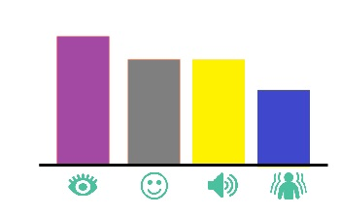
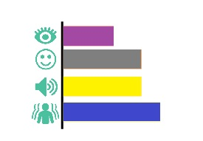
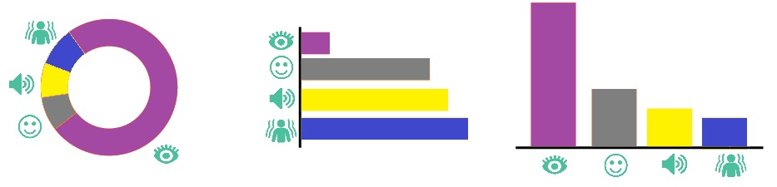
Summary Post Feedback
Reminder
Best Streak
Response Lag
First
Session
Second
Session
Notes:
After having the conversation user can look at their summary feedback. The reminder means how many times the user got a particular type of red flash. The best streak means for long the user kept a particular icon green. The response lag indicates how long did it take to make a red icon into a green one. You can see that user can compare their results between their training session. In this particular case, the user got worse in their eye contact but improved his body language.

Slide 16
Study
In the context of speed date
Measurable behaviors and outcomes
Control for variables.
Notes:
In order to validate our system we conducted a study in the context of speed dating. This approach are increasingly used in research on romantic attraction. Speed dates allows us to measure the behaviors in a open ended conversation where participants can show their real world emotions. In Speed date it is easy to control different variables.

Slide 17
Participants
47 male undergraduate students
8 female research assistants
Trained to conduct speed dates
Consistent throughout the study
18 years old or older and Native English speakers
Notes:
We recruited 47 male undergraduate students. We invited 5-6 participants per day. We also recruited 8 female RAs. The female RAs were trained to conduct the speed date study and maintain consistency throughout the study. All of our participants were 18 yo and native English speakers. We restricted ourselves by targeting only male population just to control the variable.

Slide 18
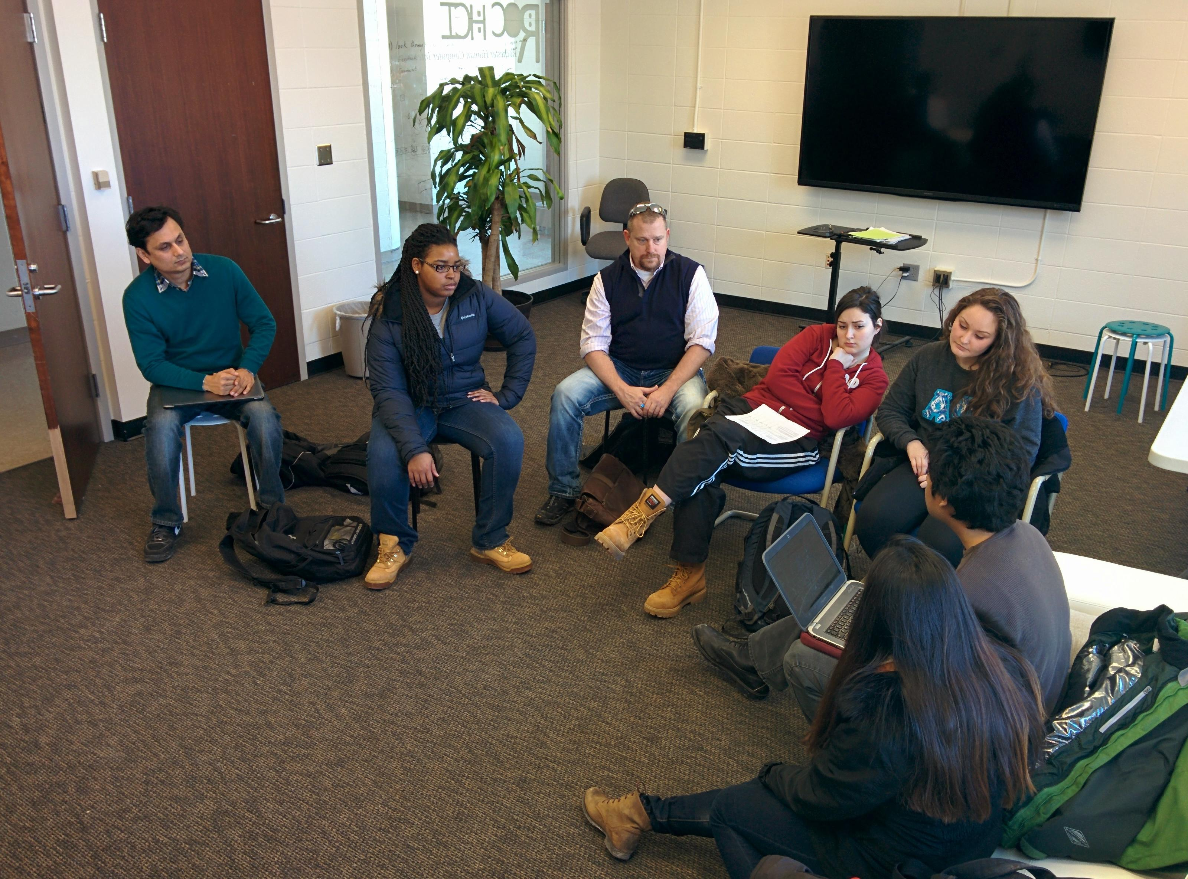
Training session
Notes:
To make sure that all of our staffs, RAs, and Wizards maintain consistency we used to have 1 hour training sessions.

Slide 19







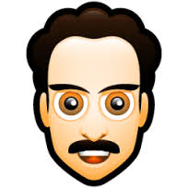


Study
Speed Date
Round 1
Speed Date
Round 2
Notes:
In our study we had two rounds of speed date. In a speed date, several men and women participates. Each of the participants are paired up and they are allowed to have a conversation. After approximately 4-5 mins the men changes their positions and starts a new conversation. In this way each men and women can talk to each other. After the first round of speed date we divided our participants in to two groups. One is our LISSA group who had training sessions with LISSA. The other group is the control group, they received a social skills development pamphlet and watched a youtube video on how to improve social skills. After the training session the participants had a second round of speed date.

Slide 20
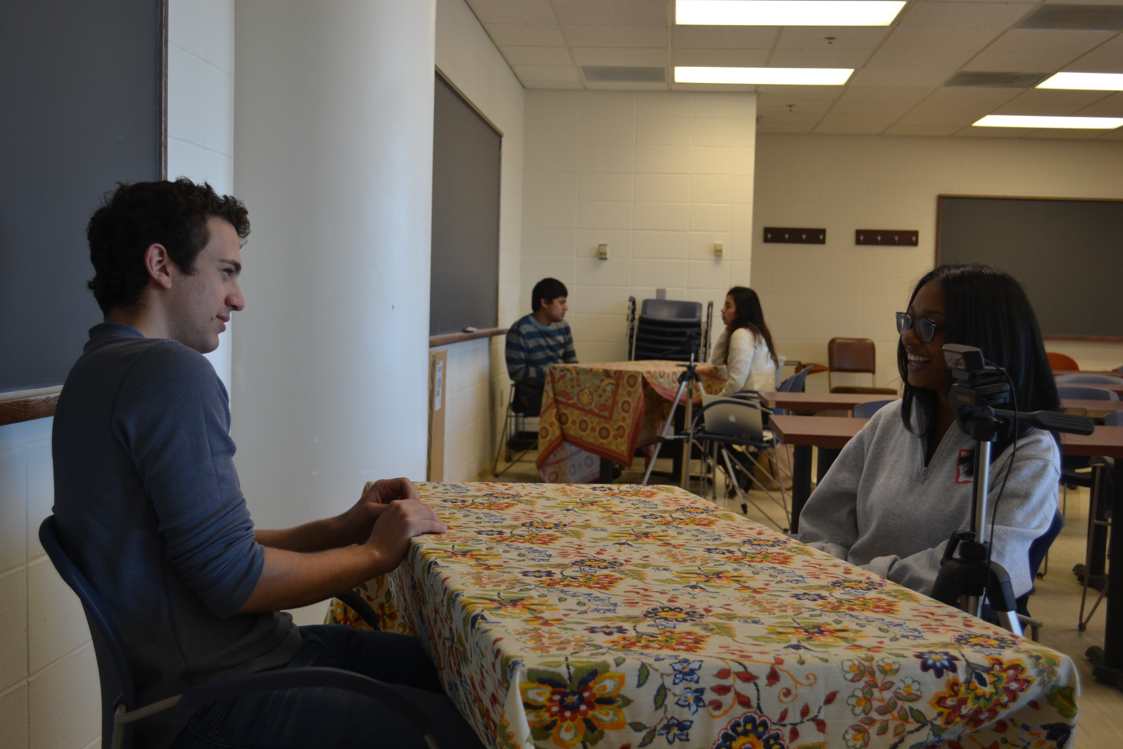
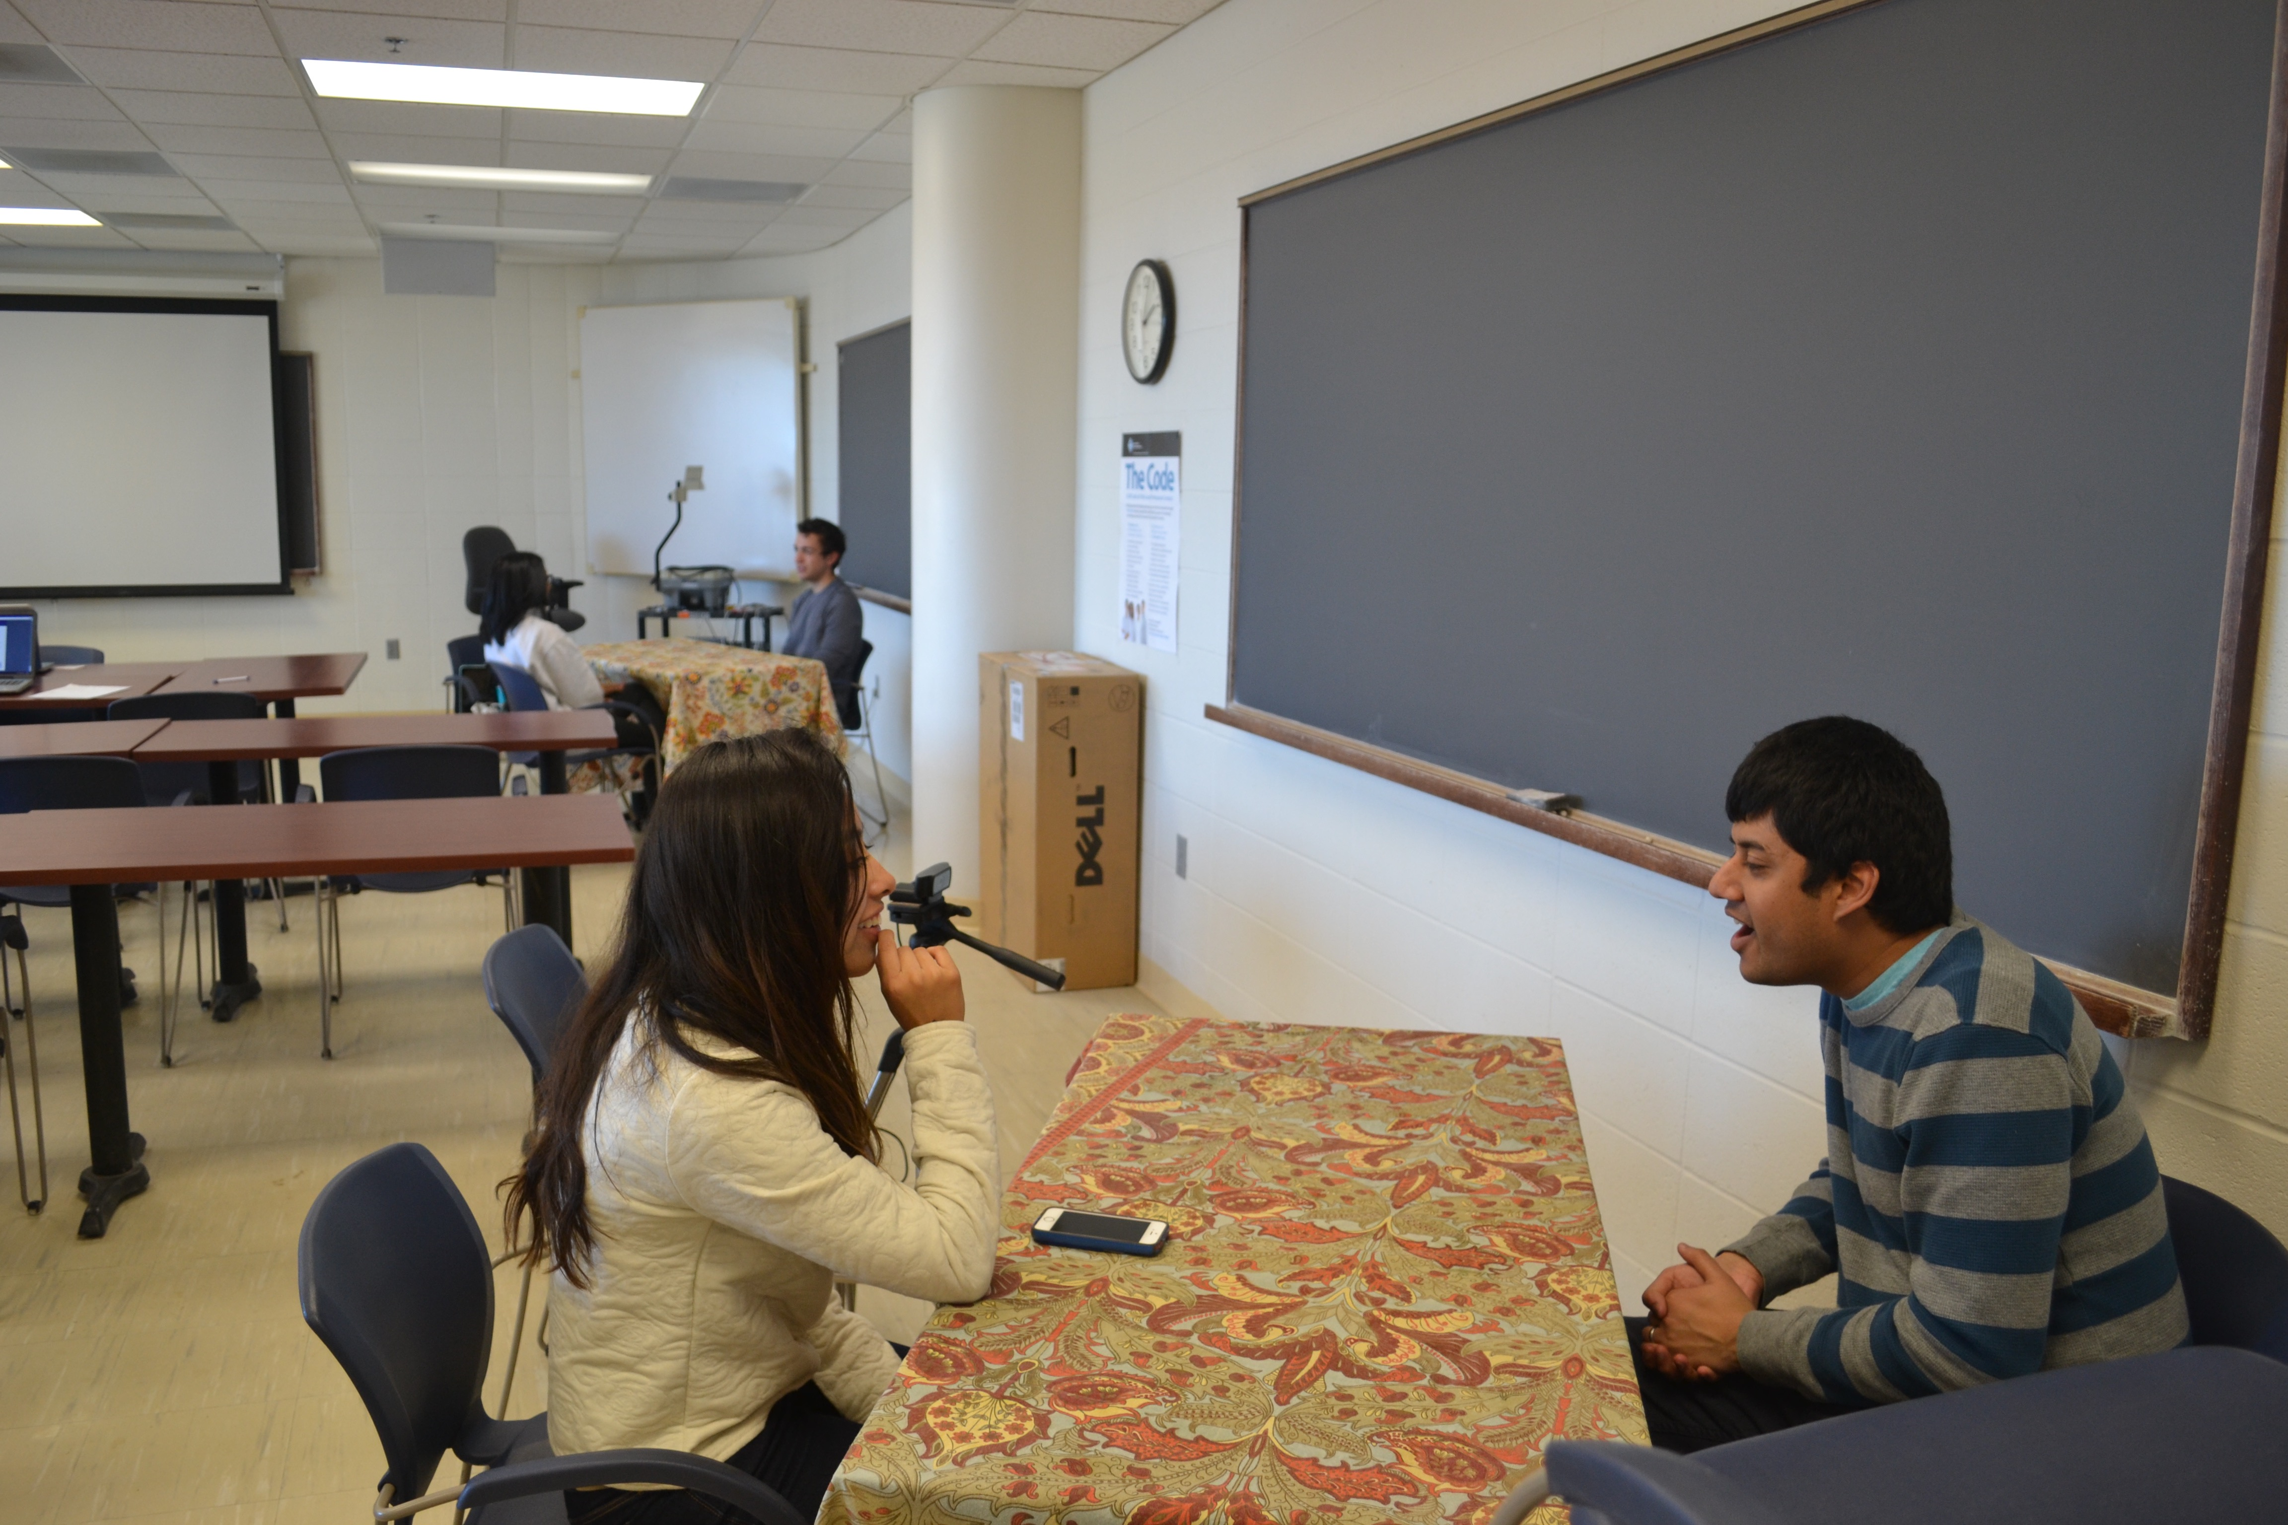
Speed date (round 1)
Notes:
These are the actual pictures of our speed date session. Every session is recorded.

Slide 21

Rating Scheme
CSRS: Conversational Skills Rating Scale
Our questions:
Use of Eye Contact
Use of gestures
Smiling
Vocal confidence
Nodding of head
A. Instructional, A. Of, and I. Competence, “Conversational Skills Rating Scale,” 2007.
Notes:
During the speed dates our RAs rated the male participants. There is a popular rating scale called “CSRS: Conversational Skills Rating Scale”. The RAs rated the male participants on their eye contact, gesture, smiling, volume, and head nods on a scale of 1 to 5.

Slide 22
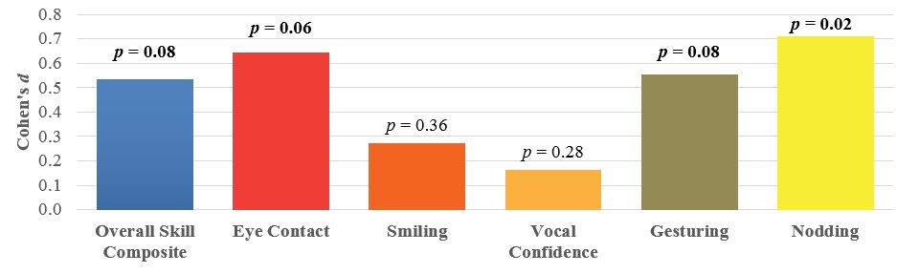
Results
Notes:
After getting all the ratings of CSRS items we averaged them for each individuals across all interactions, which gave us the baseline and post-treatment estimate. Then these 5 item estimates were created by averaging. To see the effect of the intervention on post-treatment we performed a series of ANCOVAs on averaged RA ratings for each individual item at post-treatment adjusting for initial averages for that item. In this picture we are showing the differences between the LISSA and Control condition for each skill as a Cohen’s d which scales each difference in terms of the pooled standard deviation for that group. All the items are in positive direction. We only saw significant higher ratings on head nodding and marginal effect on guesturing and eye contact.

Slide 23

Notes:
Here is a video of a participant having interaction with our RA in a speed date. As you can see it is clear that after LISSA session this person improved his body movements, and smiling.

Slide 24
System Usability
SUS = 69, SD = 10
Useful (p = 0.02)
Accurate (p = 0.01)
Consistent (p = 0.02)
Unrealistic (p < 0.01)
Notes:
In terms of system usability LISSA showed positive results. Our SUS score was 69 with SD 10 in a scale of 1 to 100. We asked participants to fill out surveys after each LISSA sessions. From there we found that LISSA was useful, Accurate in terms of giving feedback, and consistent throughout the session. However, they also said that LISSA’s dialogues were unrealistic.

Slide 25
Comments from our participants
“LISSA could be improved by having more fluid natural responses that are less monotonous.”
“It was a good way to practice body language. I think if the actual conversational abilities were more realistic then it would be greatly improved.”
Notes:
These are some comments from our participants.

Slide 26
Future Work
Automatically give real-time feedback
Have an automated conversation (getting rid of wizards)
Engage different population (women, older adults, Children diagnosed with ASD)
Try different feedback scheme
Notes:
In future we will make our system automated. During our study we collected 46 videos each of which 8-10 mins long. We will also automate our dialogue system. We will engage different populations, for example we’ll target women, older adults, and children diagnosed with autism. And we’ll try different feedback scheme as well.

Slide 27

LISSA- Live Interactive Social Skill Assistance
Mohammad Rafayet Ali, Dev Crasta, Li Jin, Agustin Baretto, Joshua Pachter, Ronald D. Rogge, Mohammed Ehsan Hoque
Notes:
That’s all from me. If you have any questions, I am happy to answer that.

