Slide 1
ROC Comment: Automated Descriptive and Subjective Captioning of
Behavioral Videos
Mohammad Rafayet Ali, Facundo Ciancio, Ru Zhao, Iftekhar Naim, Mohammed (Ehsan) Hoque
Rochester Human-Computer Interaction (ROC HCI),University of Rochester

Slide 2


Problem
Notes:
Imagine you have to give a public speech tomorrow and you need to practice. You can practice in front of an expert and get some feedback. But this can be expensive. Another way is to record yourself and share the video with your friends. But you might need to wait for a long time to have the feedback and adjust your speech accordingly. Some people don’t want to share their video.

Slide 3
Can computers generate Human Like comments on my public speaking video?
Notes:
Now as you already have your public speaking video, you might think “Can computers generate human like comments on my public speaking video?”

Slide 4
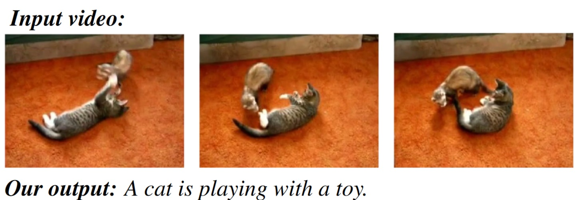
Solution? (Image/Video Captioning)
Subhashini Venugopalan, Huijuan Xu, Jeff Donahue, Marcus Rohrbach, Raymond Mooney, and Kate Saenko. Translating videos to natural language using deep recurrent neural networks.

Slide 5
Can computers generate Human Like comments on my public speaking video?
YES
Notes:
Now answer to this question will be yes.

Slide 6
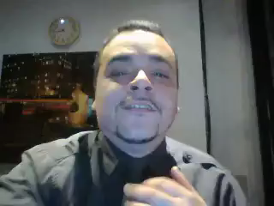

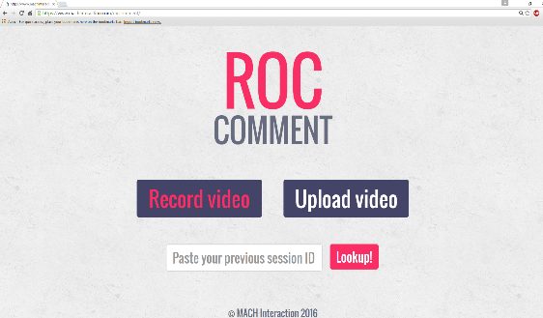
ROC Comment https://www.tinyurl.com/roccomment
Notes:
We developed ROC Comment, an online tool. You can practice you public speaking and get personalized feedback without sharing your video with a human. All you have to do is go to our website and record your video. Like this.

Slide 7

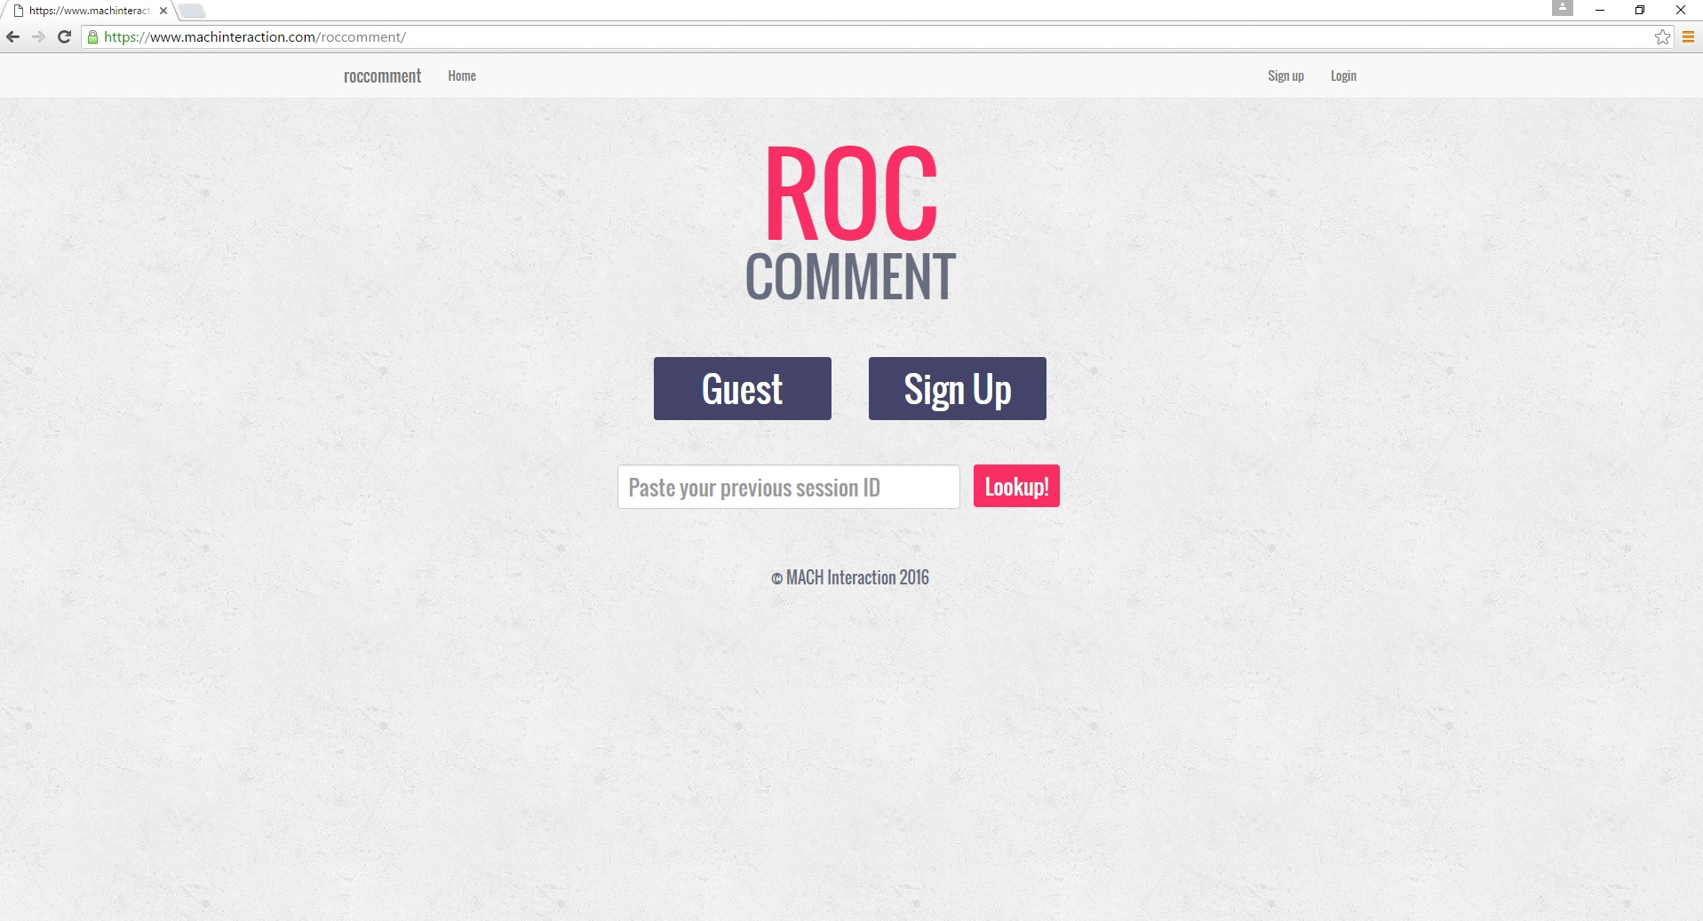
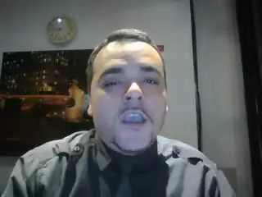

Very good starting with a great clear voice. #VoiceModulation
He/She needs to smile here. It makes the speech more natural. #Smile
Speaker seems friendly, makes you feel like he/she is talking to a friend. #Friendliness
He/She is not utilizing eyes. It looks like he/she is reading from a script.
Show More
Notes:
Our system will analyze the nonverbal features, smile, volume, body movement of the video and generate personalized comments on your video.

Slide 8







Data Set
196 videos by 49 individuals
Topics:
  Favorite hobby
  How to find cheap airline tickets
  Does real learning happen outside
  the classroom?
  Should children watch less television?
  A mock graduation speech.
12,173 comments by more than 500 human judges
Notes:
In order to build this system we collected data. We collected 196 videos from 49 individuals. We gave them 5 topics. … then we collected 12,173 comments from 500 human judges. All the speakers are online workers.

Slide 9
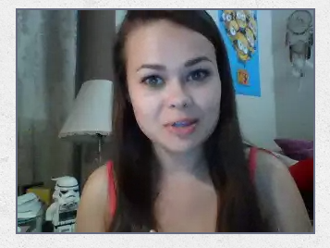
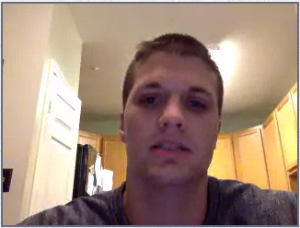
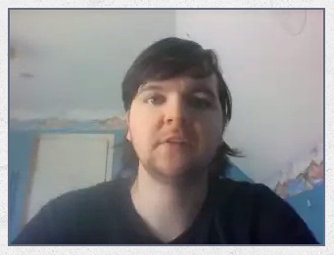
Data Set
Recorded in own environment
Different Microphone and webcam setting
Comments were short and specific.
Notes:
We faced some key challenges with the data. All the videos were collected in the speaker’s own environment. They had different camera and microphone settings. Also, some of the the comments we collected were too specific and short.

Slide 10

Data Set
Notes:
Here are some example videos. You can see that this person is mumbling. She has a cluttered background. This person is sitting close to the camera but has a low volume.

Slide 11
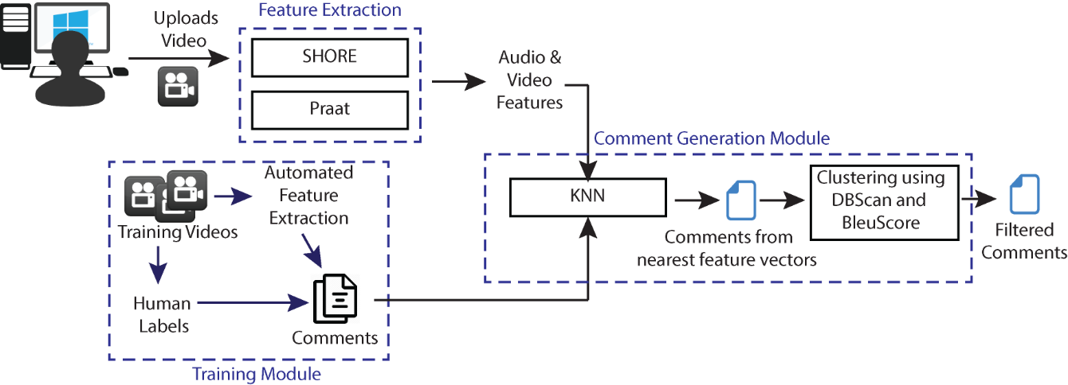
System
Notes:
This is how our system works. User first uploads their video. Then our system extracts the facial and prosodic features. We extract smile intensity, body movement, speaking volume. From the training data we select the closest comments using a KNN based model. Then we cluster them using DBScan algorithm and throw out the outliers.

Slide 12
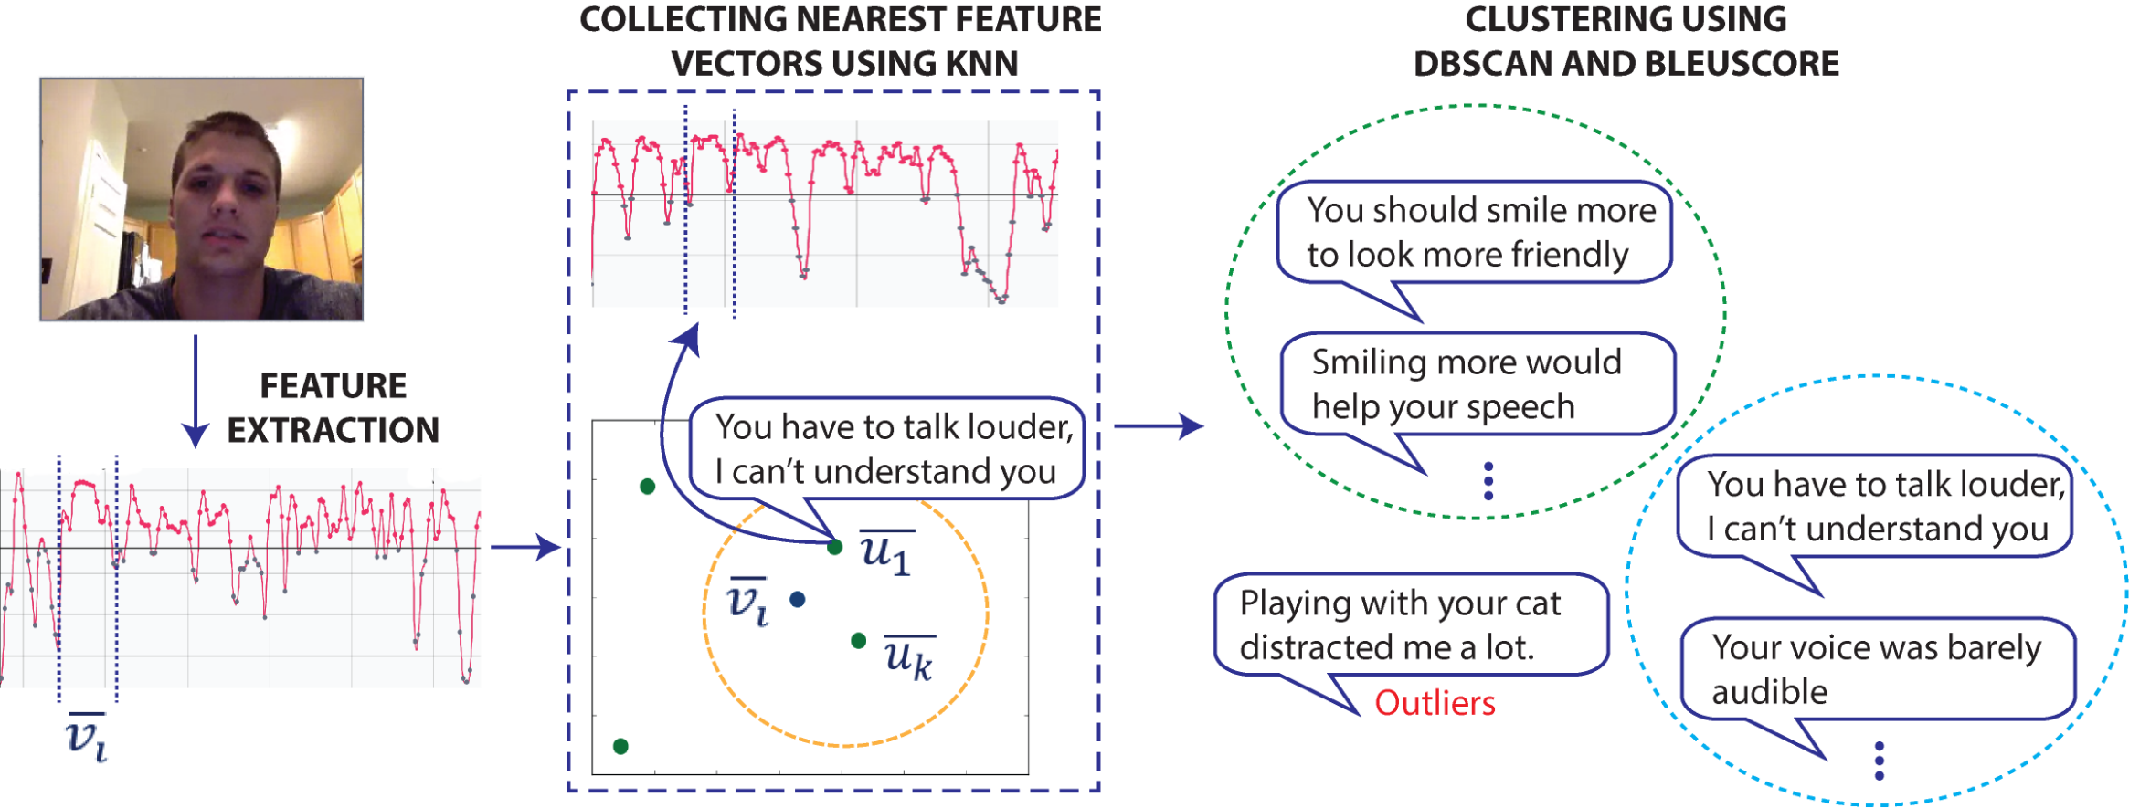
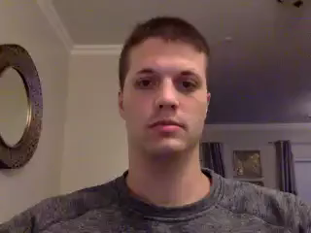
How it works
Notes:
Let me explain this with an example. This is a user video.

Slide 13


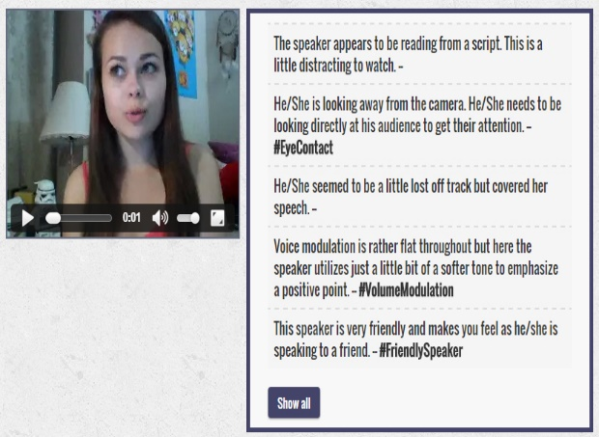
Validation Study
30 Participants (Mechanical Turkers)
Record and Upload a Video
Receive Comments

Slide 14



Results
Out of Context
(2.10/6.00)
Speaker should emphasis on his hobbies and speak louder. #Loudness
Accurate(3.33/6.00)
Your voice modulation is very good. Keep it up. #VolumeModulation
Helpful(3.53/6.00)
Speaker is very friendly, makes it feel like he/she is talking to a friend #Friendliness
Show More
Show More
Show More

Slide 15
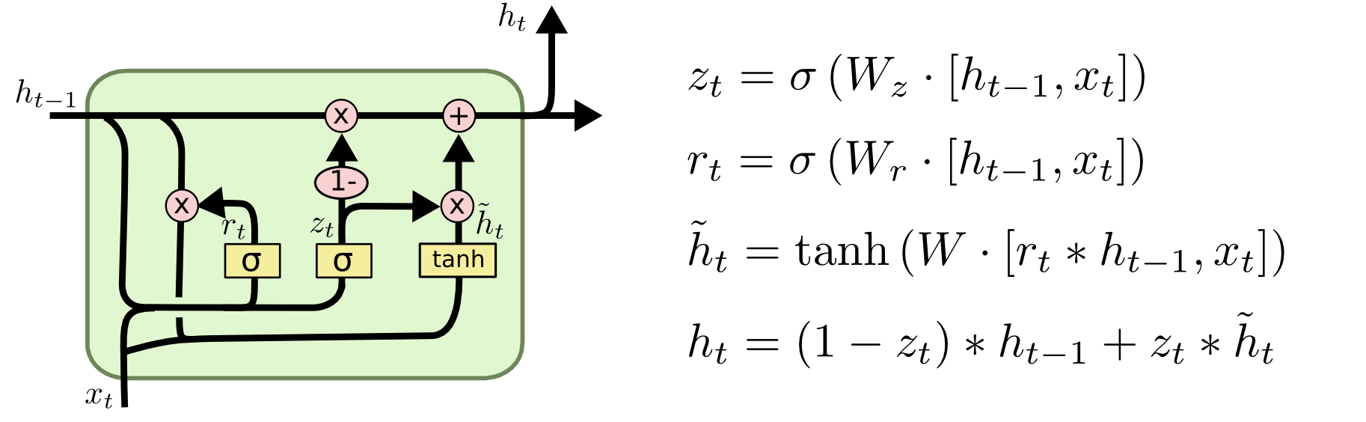
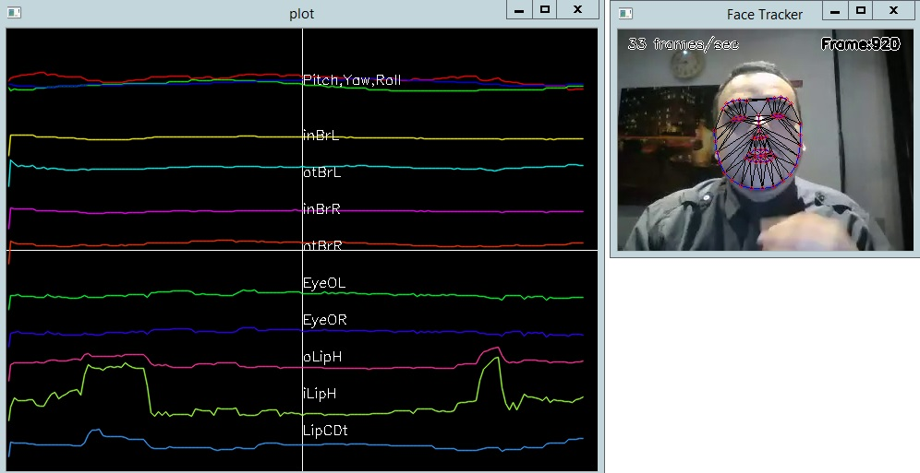
Future Work
Use Recurrent Neural Network (LSTM)
Use more useful features (eye position)
Eliminate out of context comments (Detect Topics)

Slide 16
ROC Comment: Automated Descriptive and Subjective Captioning of
Behavioral Videos
https://www.tinyurl.com/roccomment
Mohammad Rafayet Ali, Facundo Ciancio, Ru Zhao, Iftekhar Naim, Mohammed (Ehsan) Hoque
Rochester Human-Computer Interaction (ROC HCI),University of Rochester

